Slide 1


Get testing with tSQLt Practical examples and automation
Steve Jones
SQLServerCentral
Red Gate Software
Notes:
Grant will be modifying the talk w/c 1st September to shorten and refocus
50:50 ratio of content on CI and release management
Make it clearer that CI is the natural next step on from version control
Go into more detail on CI as a process
Cut out demo on version control as an entity
Reduce rollback and recovery slides to one slide

Slide 2
Agenda
Refactoring an application
Testing procedures and functions
Testing exceptions
Grouping tests
Goals
Who am I?
The Delivery Pipeline
Where do I test?
Why do I test?
tSQLt

Slide 3
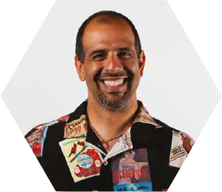

Get in touch
Steve Jones
www.voiceofthedba.com
sjones@sqlservercentral.com
@way0utwest
/in/way0utwest

Slide 4
Goals
Why testing matters
Introduction to the tSQLt framework
What and how we can test
Testing as part of a deployment pipeline

Slide 5
Database release pipeline
Development
Continuous Integration
Testing
Production
Database development
and change management
Operations
QA / Test / Pre-production
Continuous integration
ALTER
TABLE
foo…
Review,
Backup
& deploy
Build
Test
Deployment script
Source control
Trigger
Release management
Production
Publish
Sync
Artifact repository
Development
Continuous delivery for databases

Slide 6
Continuous integration – an overview
Automatically run by CI build server
Build
Test
Trigger
Source control
Publish
Sync
Release management

Slide 7












Platinum Level Sponsors
Gold Level Sponsors
Venue Sponsor
Key Note Sponsor
Pre Conference Sponsor

Slide 8









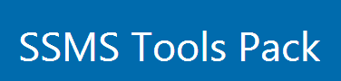
Silver Level Sponsors
Bronze Level Sponsors

Slide 9
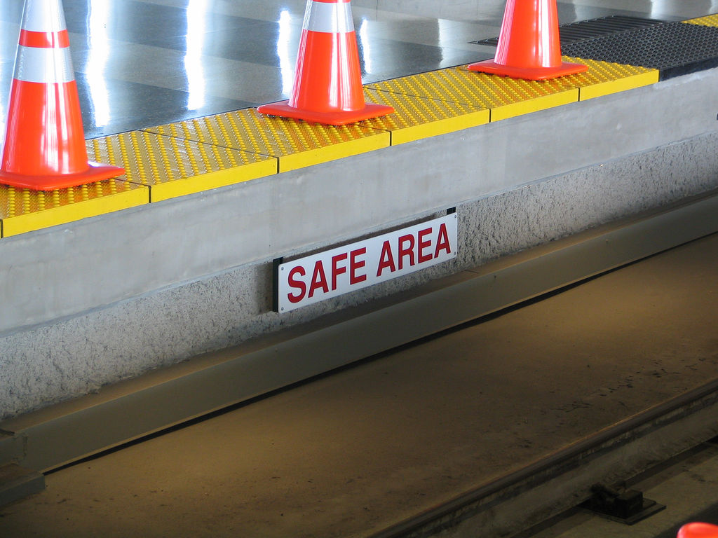
First…the big question When do I test?

Slide 10
Different types of test
Development
Integration Testing
QA
Pre-Production/ Staging
Production
Unit tests
Integration tests
Acceptance tests
Deployment validation
Behaviour validation
Performance tests
Other validations
Notes:
We use this slide in the Build a Pipeline talk at the very end to touch on the range of tests that you can cover in a pipeline. Perhaps we could reuse here to give further emphasis? I’ve added some animation in case you’d like to build up the pipeline and types of tests step by step on the slide. I see the terms used for the tests and environments here aren’t consistent with the ones you mention in your Testing in the Pipeline slide (hidden for now below). Should we update this slide here to reflect the terms you use in your Testing in the Pipeline slide? I think your pipeline slide with the arrow also works very nicely though – so just let me know which you prefer to use (or both!).

Slide 11
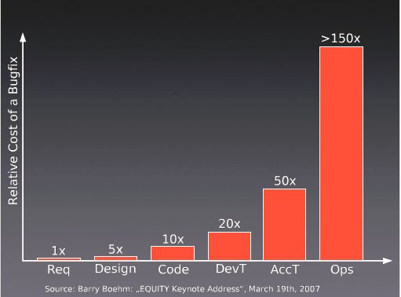
Why test?
Notes:
Note that the cost of bugs rises. We know this. The earlier we find issues, the better. We can see from this survey that the cost of bugs rises dramatically as we get closer to the client.

Slide 12
“Fix bugs as soon as you find them”
Unfixed bugs distract the entire team
Unfixed bugs hinder short-notice releases
Unfixed bugs lead to inaccurate estimates
Fixing familiar code is easier than unfamiliar code
Fixing a bug today costs less than tomorrow
Unfixed bugs camouflage other bugs
Unfixed bugs suggest quality isn’t important
Discussing unfixed bugs is a waste of time
Unfixed bugs lead to duplicate effort
Unfixed bugs lead to unreliable metrics
Notes:
I found this post and thought it might make quite a nice summary slide from a testers’ perspective of why it’s important to fix bugs early – especially with the potential for a snowball effect if unfixed bugs just camouflage other bugs. What do you think?

Slide 13
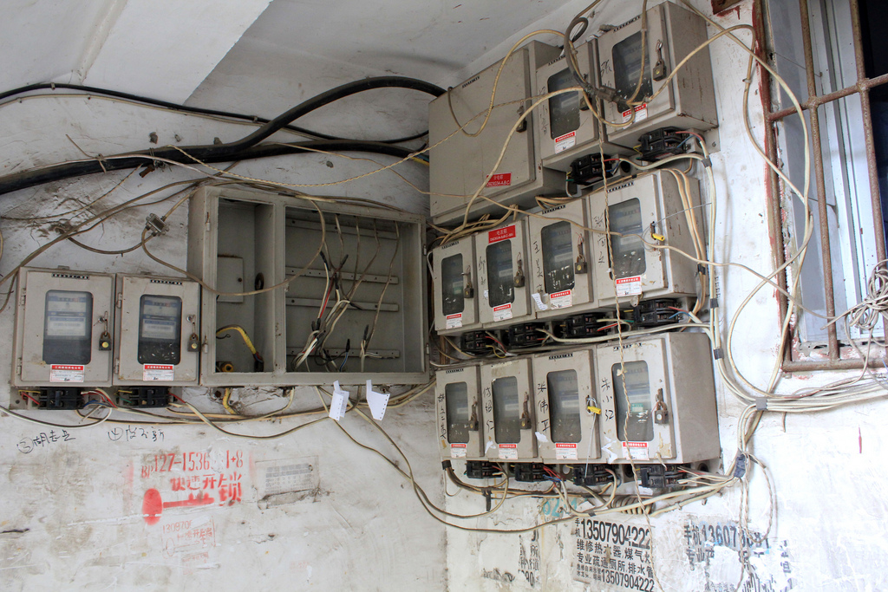
The next question: What do I test?
Notes:
thought it might be helpful early on to establish what it’s useful to test as a quick recap. What do you think?

Slide 14
How is data retrieved, stored and maintained in your application?
“[SQL code] includes views, stored procedures, functions, triggers, the creation of tables and the relationships between them, and query statements embedded in other programming languages.”
“…Writing this code often involves decisions about the nature of data being processed, complicated joining and filtering, performance tuning, data cleansing, replication and data maintenance.”
Source: Sebastian Meine and Dennis Lloyd – “SQL Server Unit Testing with tSQLt” – simple-talk.com

Slide 15
What do we test?
Calculations in procedures and functions
Constraints
Edge cases of data DML
Expected behavior of data DML
Error Handling
Standards

Slide 16
Demo
Standards
Ensure that the standards you care about are followed.
SQLCop – sqlcop.lessthandot.com
Easy to write your own

Slide 17
Why tSQLt?
Free framework, similar to nUnit/jUnit
Tests written in T-SQL
Can use SSMS IDE
Run tests singly, in groups and in any order
Self-contained tests – isolated transaction
Includes common assertions to reduce repetitive coding
Requires the SQLCLR
Notes:
Introduce the framework. Give URL, support, this is free.
Steve, I’ve added in some extras here – don’t know if that’s useful or if you agree. I found the info in this article: https://www.simple-talk.com/sql/t-sql-programming/test-driven-database-development-%E2%80%93-why-tsqlt/

Slide 18
Structure of tests
Classes
Group by object/area being tested
Layout
Assemble
Act
Assert
Tests fail first

Slide 19
Our user story…
Reader on our Simple-Talk website:
I want to be able to see how long it will take me to read an article.
Notes:
Needs a new name, but this is where we talk about our demo app slightly (or code). Give a first requirement we need to do.

Slide 20
Our tasks…
We need to refactor and adjust the reading time for articles
To do
Doing
Done
Add a column to our table
Proc to update reading time
Test an edge case
Group tests and execute
Notes:
We have four tasks on our whiteboard. We’ll add a column to our table first.

Slide 21
Demo
Testing the API
Our first test
tsqlt.AssertResultSetsHaveSameMetaData

Slide 22
Our tasks…
We need to refactor and adjust the reading time for articles
To do
Doing
Done
Proc to update reading time
Add a column to our table
Test an edge case
Group tests and execute
Notes:
We have four tasks on our whiteboard. We’ll add a column to our table first.

Slide 23
Demo
Procedures and functions
Test the function
Create a new procedure
Isolate the procedure from the function in a test

Slide 24
Our tasks…
We need to refactor and adjust the reading time for articles
To do
Doing
Done
Proc to update reading time
Add a column to our table
Test an edge case
Group tests and execute
Notes:
We have four tasks on our whiteboard. We’ll add a column to our table first.

Slide 25
Exceptions
Our code needs good error handling
We want to test for this by:
Creating errors with edge cases
Testing for specific exceptions when we use bad data

Slide 26
Demo
Exceptions
Send in bad data in a test
Update our procedure with error handling
Include a new test to catch the exception
Notes:
Send in bad data in a test
Update our procedure with error handling
Include a new test to catch the exception

Slide 27
Exceptions
NULL
-x
0
Long strings (esp char)
Nvarchar v varchar
Int/char v datetime
Formatting (mm/dd/yyyy v. dd/mm/yyyy)

Slide 28
Our tasks…
We need to refactor and adjust the reading time for articles
To do
Doing
Done
Proc to update reading time
Add a column to our table
Test an edge case
Group tests and execute
Notes:
We have four tasks on our whiteboard. We’ll add a column to our table first.

Slide 29
Building a Test Suite
By continuing to grow your test suite with each change, developers spread the load
By having a large suite, we have better code coverage
We can easily regression test
However, we need to group tests…

Slide 30
Our tasks…
We need to refactor and adjust the reading time for articles
To do
Doing
Done
Proc to update reading time
Add a column to our table
Group tests and execute
Test an edge case
Notes:
We have four tasks on our whiteboard. We’ll add a column to our table first.

Slide 31
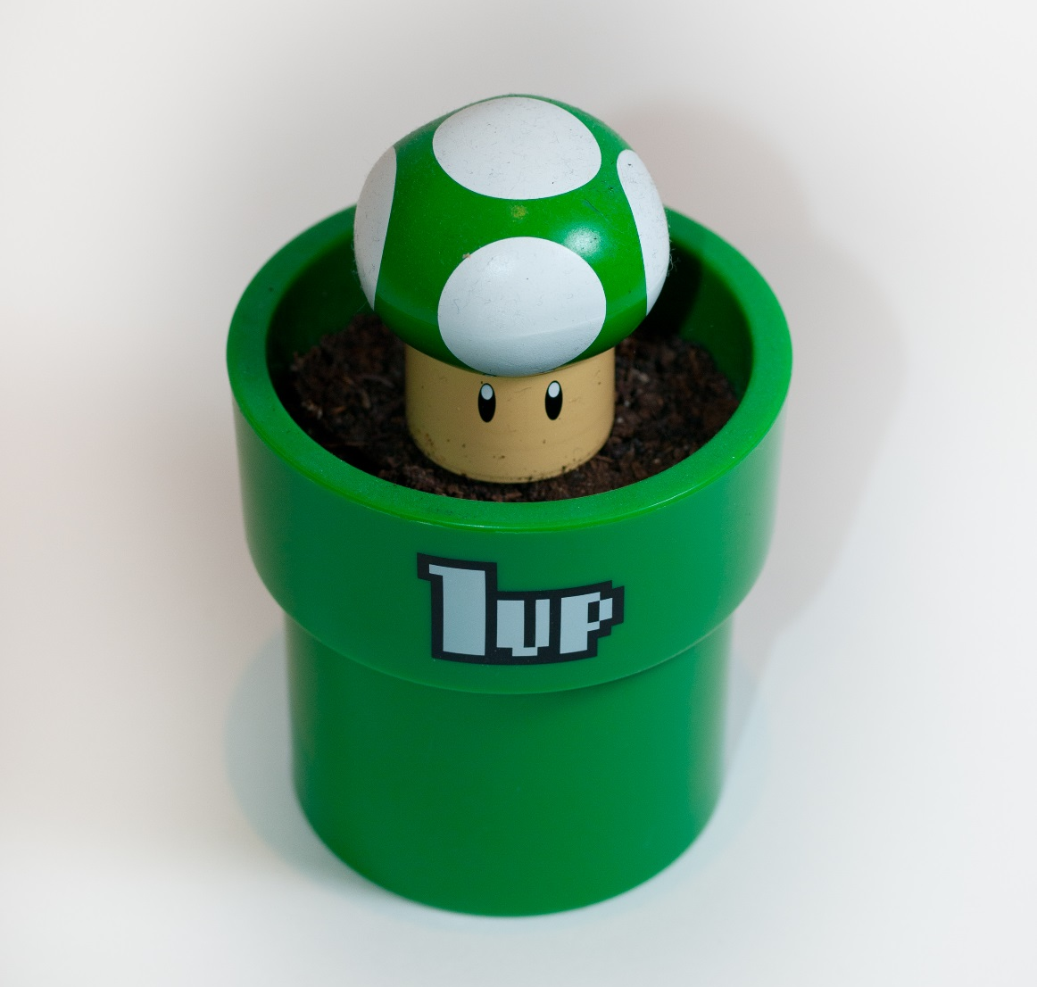
Write one extra test
Notes:
thought it might be helpful early on to establish what it’s useful to test as a quick recap. What do you think?

Slide 32
Goals
Why testing matters and what it contributes
Introduction to the tSQLt framework
What and how we can test - examples
Testing as part of a deployment pipeline

Slide 33
Any questions?
www.sqlservercental.com
www.simple-talk.com Patterns and Practices library
tSQLt.org
www.voiceofthedba.com
sjones@sqlservercentral.com
@way0utwest
/in/way0utwest

Slide 34
References
Continuous Integration – http://en.wikipedia.org/wiki/Continuous_integration
Getting Started Testing Databases with tSQLt - https://www.simple-talk.com/sql/t-sql-programming/getting-started-testing-databases-with-tsqlt/

Slide 35
Image sources
Author | Source | Information
Peter Kaminski | Flickr | Safe Area – Flickr. This file is licensed under the Creative Commons Attribution 2.0 Generic license.
Harold Groven | Flickr | Fuse box – Flickr. This file is licensed under the Creative Commons Attribution-ShareAlike 2.0 Generic (CC BY-SA 2.0) license.
William Warby | Flickr | 1up - Flickr. This file is licensed under the Creative Commons Attribution 2.0 Generic license.

